Slide 1
Graduation Project PROGRESS
Dr. ahmed moussa shawky
Cairo university
AI Defects Detection Model

Slide 2
Steps We Took to Explore the Best Model
Improve the
VGG-16
from scratch
Tensorflow.keras
model
01
02
03
05
04
SSD MOBNET
yOLO
Models
Model

Slide 3
VGG-16 from scratch --failed
A randomly designed architecture cannot generalize well and may yield poor results when presented with new images.
We attempted to train a CNN VGG16 architecture from scratch using various platforms, such as Google Colab and Jupyter Notebook. However, the available resources were insufficient to achieve the desired outcome.

Slide 4
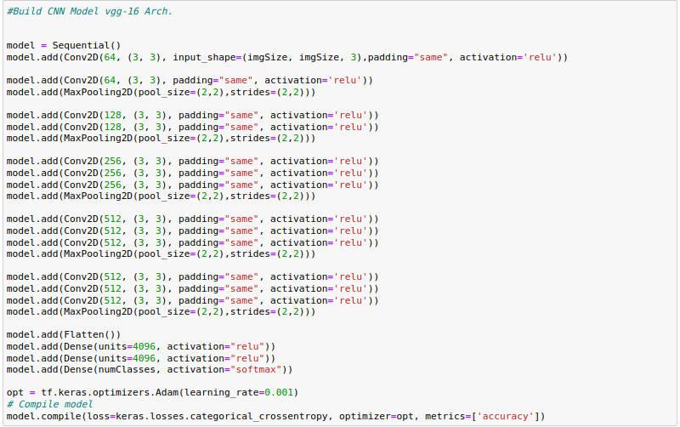

Slide 5
Tensorflow.keras Applications
Using weights of Vgg-16 model applied to ImageNet Competition 2014 and get better results in our model and become more generalize and get higher accuracy more than 95%.

Slide 6
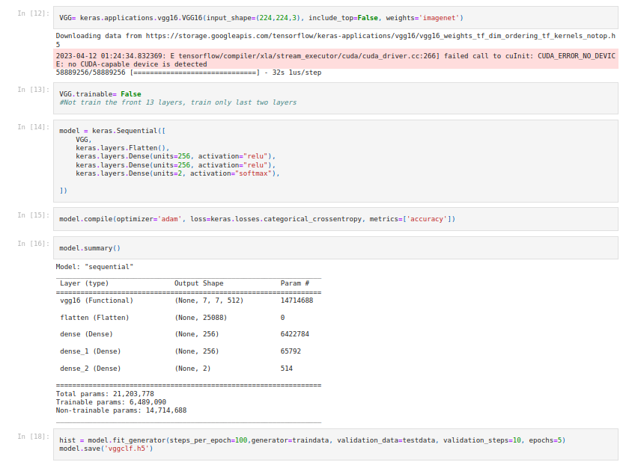

Slide 7
Improving the model
Preprocessing: Implementing data preprocessing techniques and utilizing the ImageDataGenerator in Keras to apply various actions on our data, enabling us to monitor the model's performance. These actions include rotation, shifting, flipping, zooming, and resizing.
Testing different Hyperparameters: Experimenting with various hyperparameters, such as the number of iterations, activation function, batch size, and more, to optimize the model's performance.

Slide 8
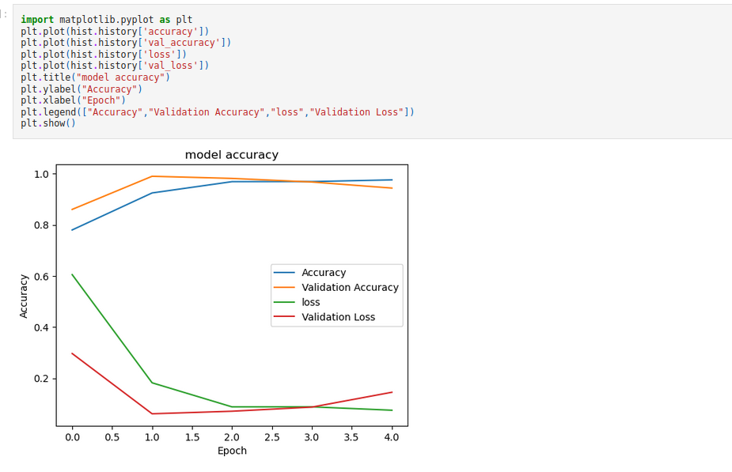

Slide 9
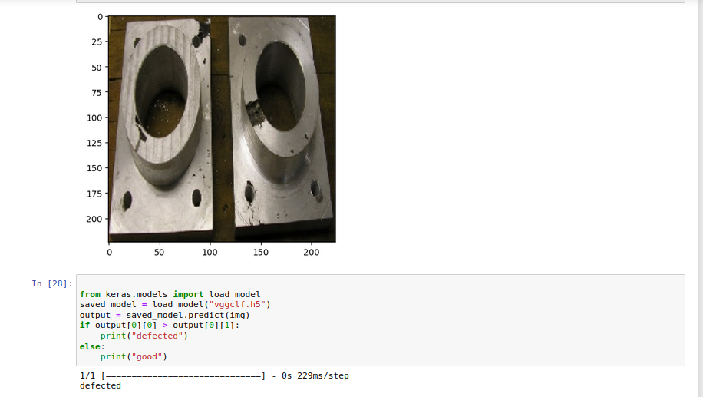
Model Predicts a New Image

Slide 10
Object Detection Model

Slide 11
Using the SSD Mobilenet Model by TensorFlow
We needed to search for a good model that achieves a trade-off between speed and efficiency.
The SSD (Single Shot Detector) Mobilenet models are specifically designed to be lightweight and optimized for mobile devices, resulting in faster and more efficient performance compared to many other object detection models.
Despite its lightweight design, SSD Mobilenet can achieve good accuracy in detecting objects in images.
Thanks to its speed and efficiency, SSD Mobilenet can perform real-time object detection, making it suitable for applications where real-time processing is an important factor in our workflow.

Slide 12
What About yolo Models?
YOLO models are more suitable to be used when:
High recall is required: If detecting as many objects as possible is more important than minimizing false positives, YOLO may be a better choice due to its ability to detect multiple objects in a single pass.
Large object detection: If the task involves detecting large objects in images, YOLO may be a better choice due to its efficiency in handling large objects.
Object tracking: If the task involves tracking objects across multiple frames in a video, YOLO may be a better choice compared to SSD Mobilenet, as it has a superior ability to handle object tracking effectively.

Slide 13
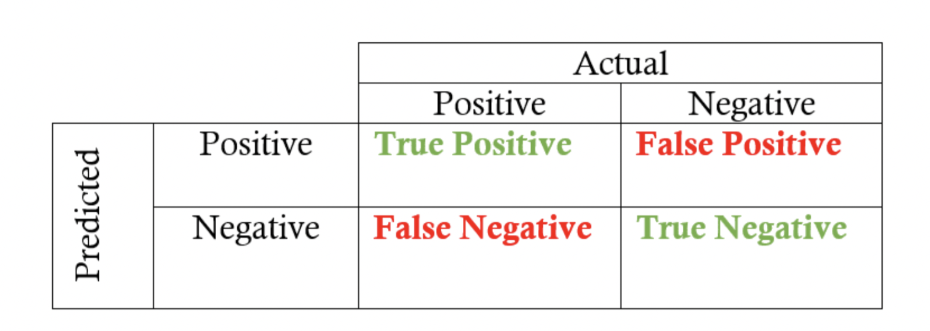
Recall explanation

Slide 14
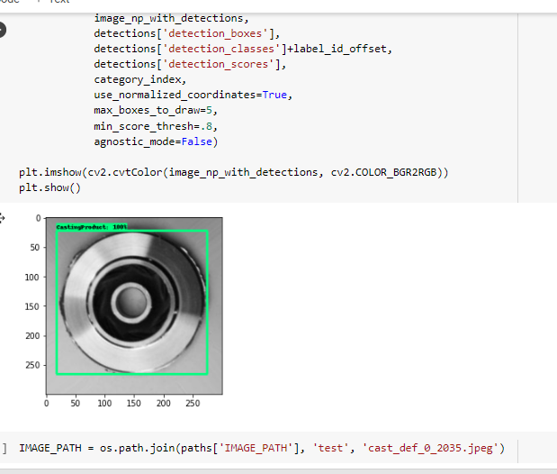
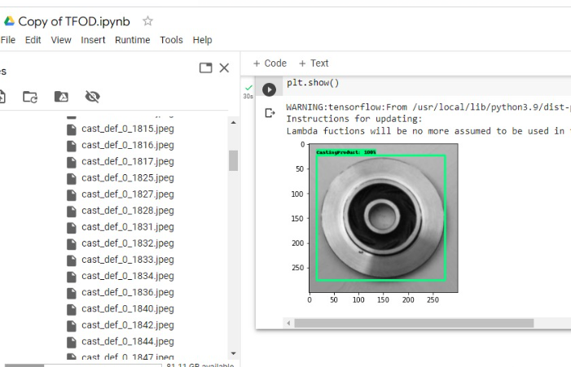
Results by the model
With threshold 0.8
Image dimensions are set to 320x320

Slide 15
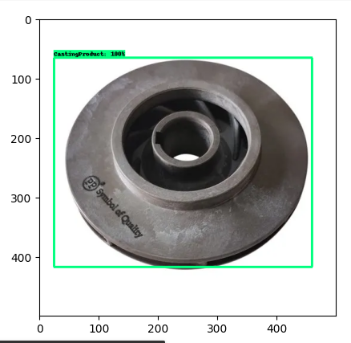
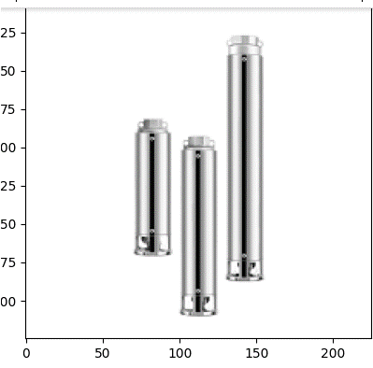
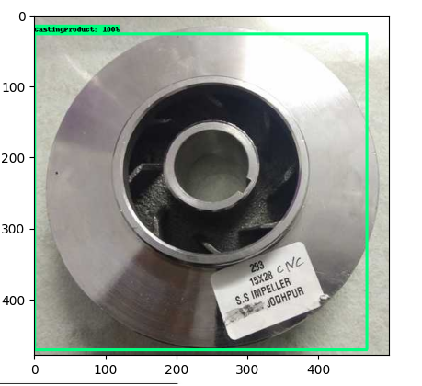
Results with New Images Added to the Dataset

Slide 16
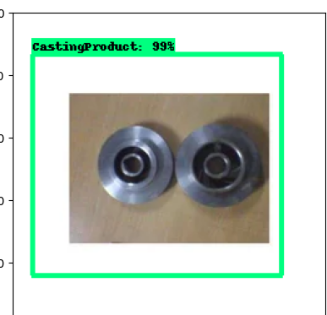
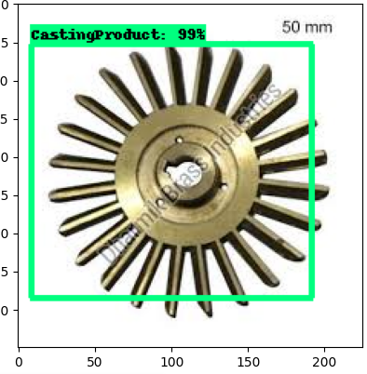
Results with New Images Added to the Dataset

Slide 17
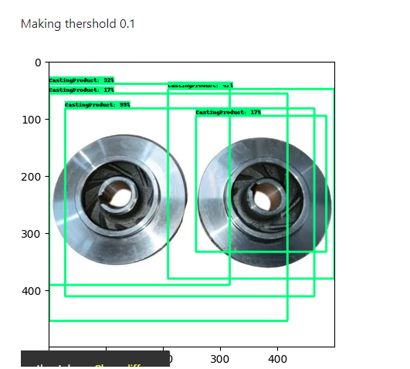
Results with New Images Added to the Dataset
With threshold 0.1

Slide 18
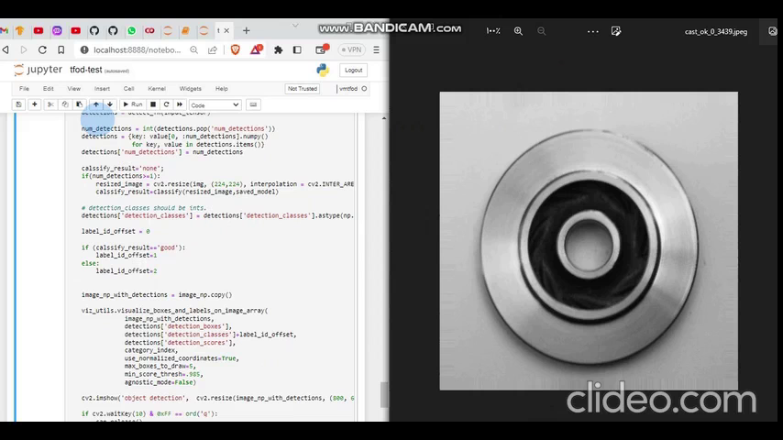
Real-time demo: detection+vgg

Slide 19
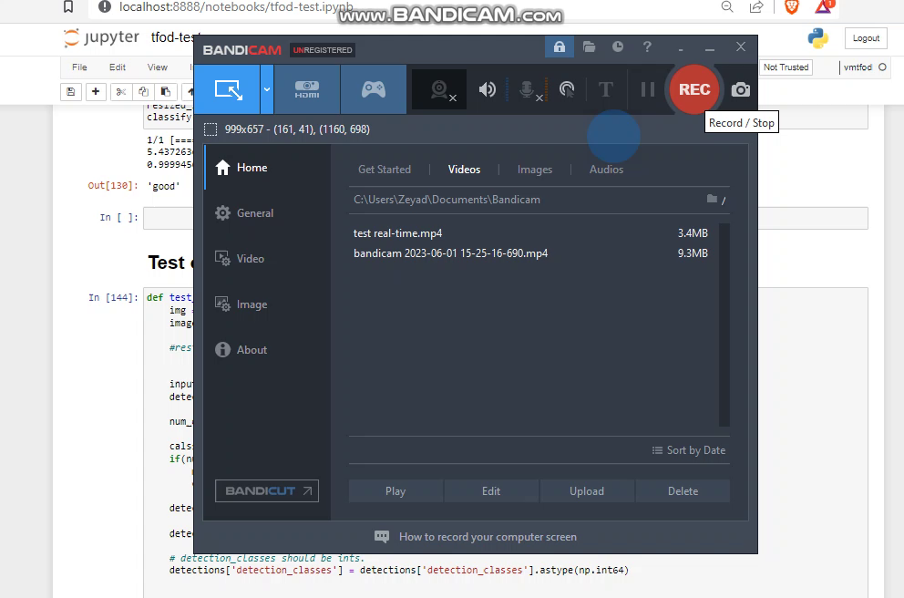
test with images: Demo

Slide 20
Deploy with Mobile APP

Slide 21
Flask Server for Testing Our Model
Working on UI/UX Design Implementation using Flutter: Focusing on designing and implementing user interface and user experience elements using the Flutter framework.
Creating a Flask Server and Hosting on Heroku: Developing a Flask server to host our models and enabling HTTP protocol requests and responses for obtaining predictions. However, we encountered a challenge where the .tflite model provided inaccurate predictions, resulting in decreased model accuracy.

Slide 22
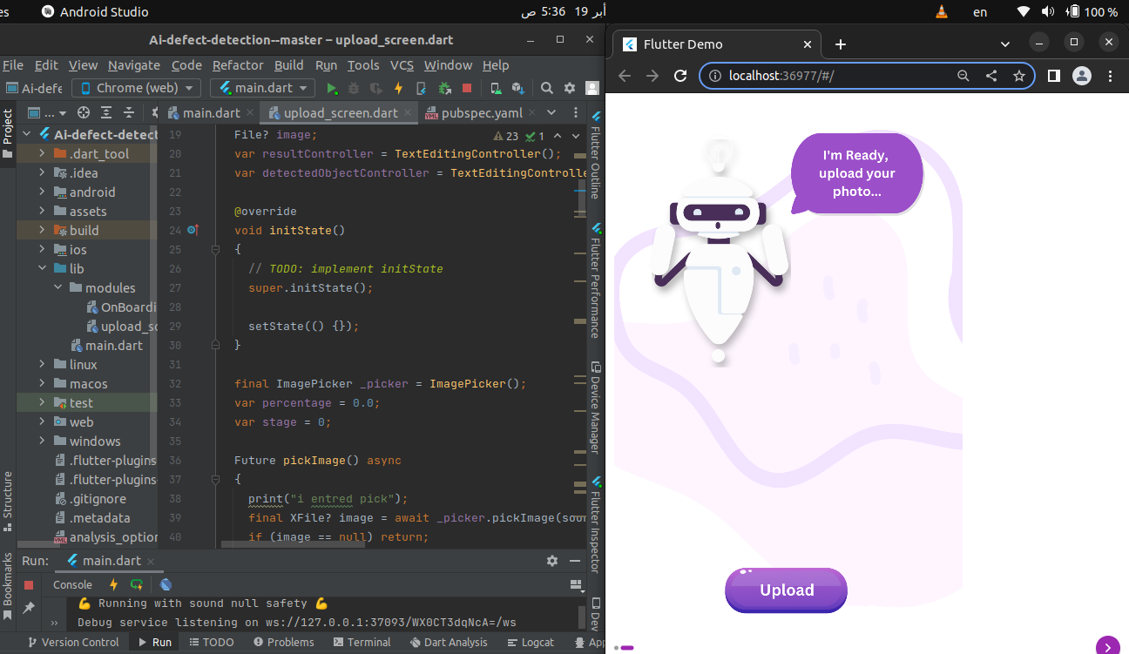
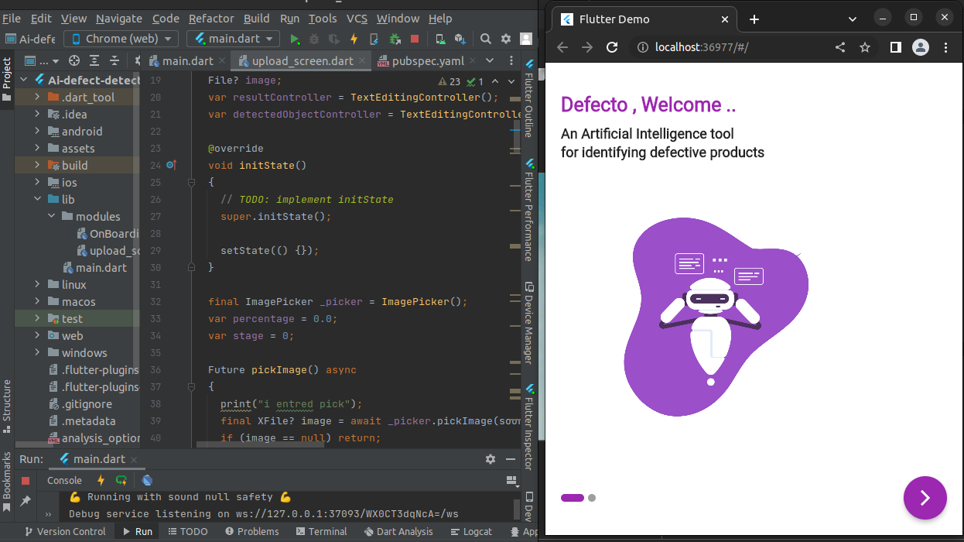
Implementing APP UI using Flutter

Slide 23
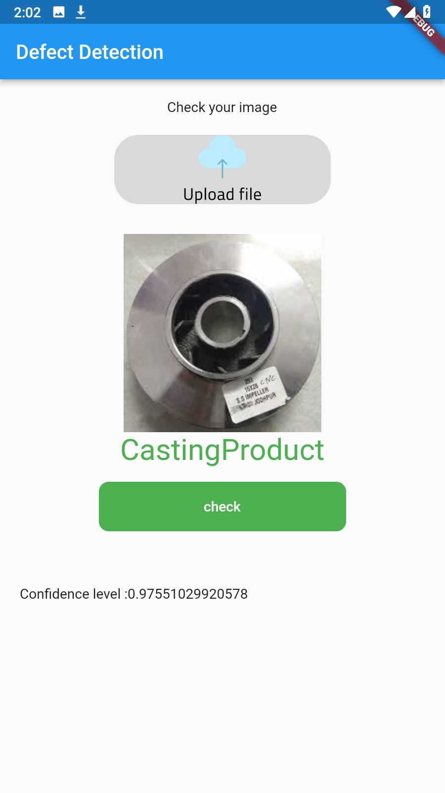
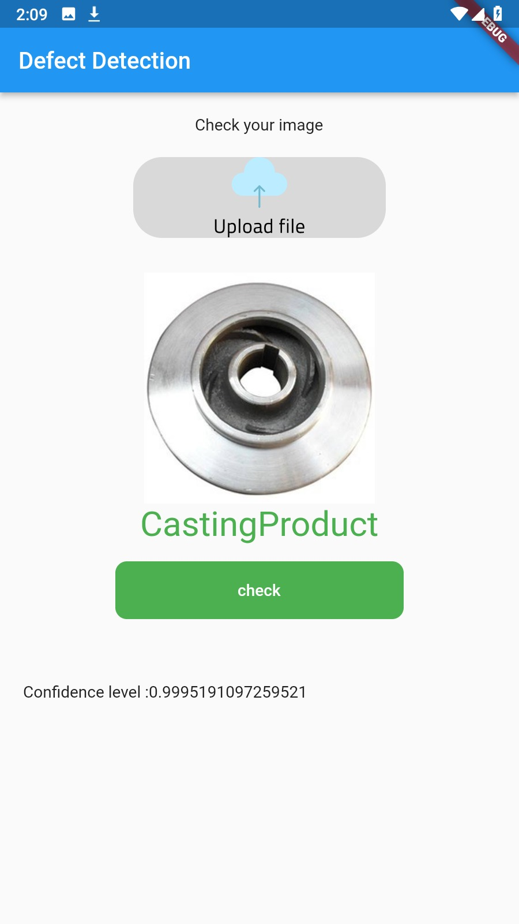
screens execute object detection for the model using Flutter.

Slide 24
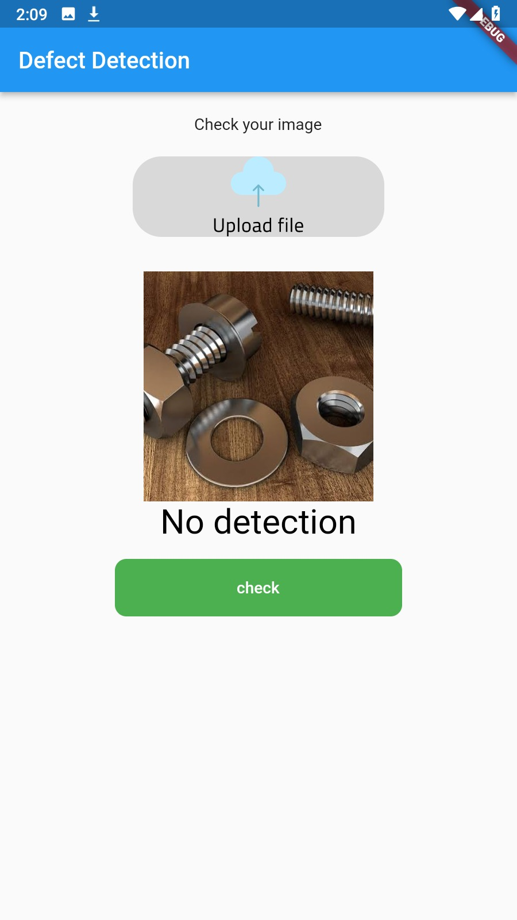
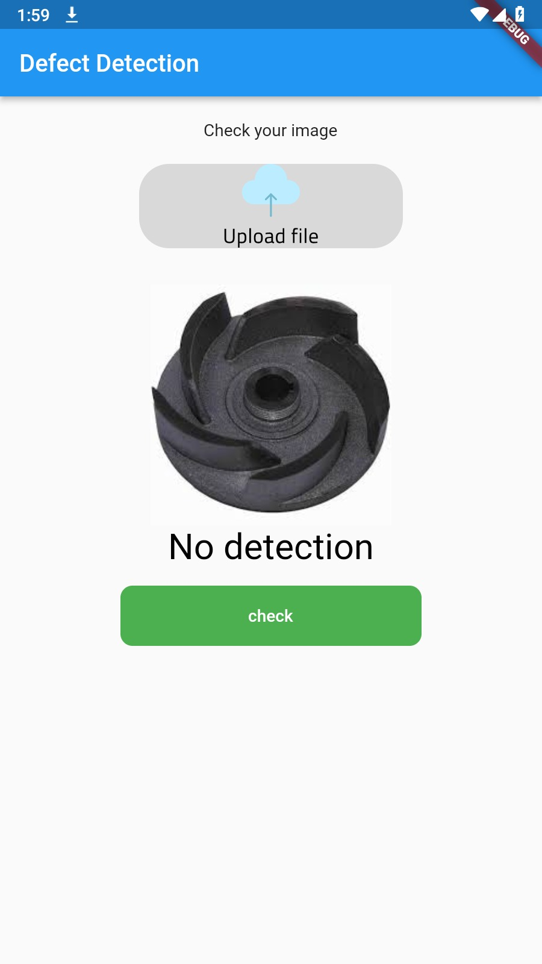
screens execute object detection for the model using Flutter.

Slide 25
Integrate the object detection model with the VGG model, and successfully upload it to Flask.

Slide 26
What are the next steps?
Implement the model in Flutter for deployment.
Connect the Flutter screens with the backend of Flask.
Model should be implemented using camera stream for real-time functionality.
We need to enhance the accuracy of object detection to effectively handle multiple objects. Consider upgrading the system with a high-performance computer to achieve this.

Slide 27
ANY QUESTIONS?

